Slide 1

Green University Of Bangladesh
Department Of Computer Science and Engineering(CSE)
Faculty Of Science and Engineering
Course Title: Linear Algebra and Vector Analysis
Course Code: CSE-105 Section: PC-221DG
Course Instructor: | Team Details:
Md. Saiful Islam Lecturer | Md. Sahid 221902057 Md. Mahim 221902082 Md. Zahid 221902091 Md. Saeid 221902092 Mejbah Jaman 221902293

Slide 2
Welcome To Our Presentation

Slide 3
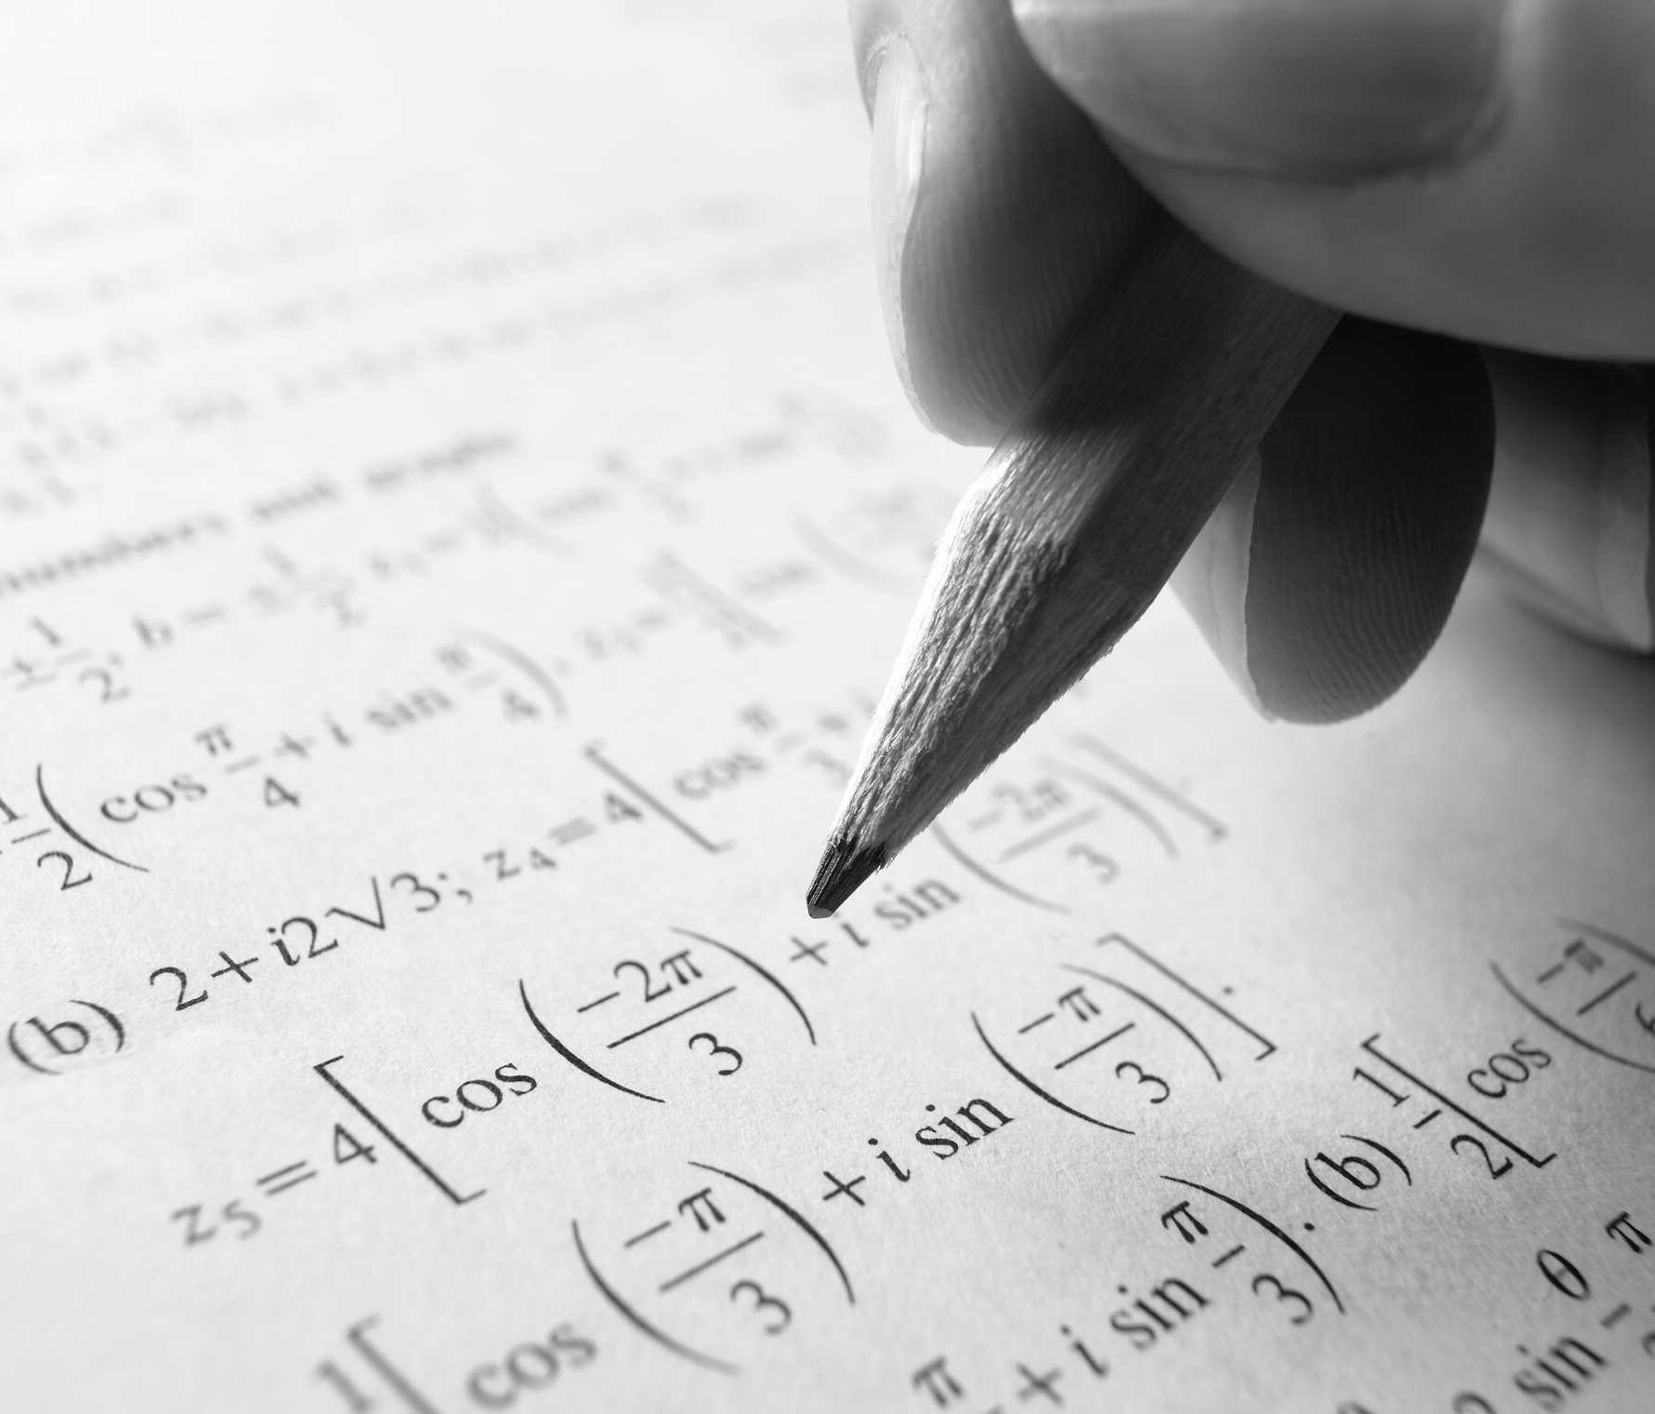
Introduction

Slide 4
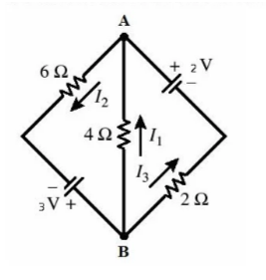

Question List
1. Determine the coefficients of the given polynomial, $p\left(x\right)=a_{0}+a_{1}x+a_{2}x^{2}$
Whose graph passes through the points (1, 3), (2, Last digit of your ID) and (3,8). Also plot the function using MATLAB command (having proper title, x and y axis notation).
2. Use suitable command to encode the message “MY FAVOURIATE FOOD IS …………” by using matrix A given below:
A=$\left[\begin{matrix}1 & 1 & −1 \\ 1 & 0 & 1 \\ 2 & 1 & 1\end{matrix}\right]$
3. Determine the currents for the electrical network shown in the following figure: Also solve the system by using MATLAB or any other programming language.

Slide 5

Question-1: Determine the coefficients of the given polynomial, $P\left(x\right)=a_{0}+a_{1}x+a_{2}x^{2}$
Whose graph passes through the points (1, 3), (2, Last digit of your ID) and (3,8).
Solution:
Determine the polynomial $P\left(x\right)=a_{0}+a_{1}x+a_{2}x^{2 }$Whose graph passes through the points(1,3),(2,1)and(3,8).
$$P\left(1\right)=a_{0}+a_{1}(1)+a_{2}{(1)}^{2}$$
$$P\left(2\right)=a_{0}+a_{1}(2)+a_{2}{(2)}^{2}$$
$$P\left(3\right)=a_{0}+a_{1}(3)+a_{2}{(3)}^{2}$$
Here,
$$a_{0}+a_{1}+a_{2}=3$$
$$a_{0}+2a_{1}+4a_{2}=1$$
$$a_{0}+3a_{1}+9a_{2}=8$$

Slide 6



The augmented matrix is,
$$\left[\begin{matrix}1 & 1 & 1 & 3 \\ 1 & 2 & 4 & 1 \\ 1 & 3 & 9 & 8\end{matrix}\right]$$
$R_{2}^{′}=R_{1}−R_{2}$ , $R_{3}^{′}=R_{1}−R_{3}$
$$\left[\begin{matrix}1 & 1 & 1 & 3 \\ 0 & −1 & −3 & 2 \\ 0 & −2 & −8 & −5\end{matrix}\right]$$
$${ R}_{3}′′={2R}_{2}′−R_{3}′$$
$$\left[\begin{matrix}1 & 1 & 1 & 3 \\ 0 & −1 & −3 & 2 \\ 0 & 0 & 2 & 9\end{matrix}\right]$$

Slide 7



From the matrix we get
$a_{0}+a_{1}+a_{2}=3$ --------(i)
${−a}_{1}−{3a}_{2}=2$ --------(ii)
${2a}_{2}=9$ -------(iii)
From the equation (iii) we get,
$${2a}_{2}=9$$
$$a_{2}=\frac{9}{2}$$
$$a_{2}=4.5$$
Putting the value of $a_{2}$ in equation (ii),
$${−a}_{1}−{3a}_{2}=2$$
$${−a}_{1}−3\left(4.5\right)=2$$
$$a_{1}=−15.5$$
Putting the value of $a_{1} and a_{2}$ in equation (i)
$$a_{0}+a_{1}+a_{3}=3$$
$$a_{0}−15.5+4.5=3$$
$$a_{0}=3+11$$
$$a_{0}=14$$
So the polynomial function is
$$p\left(x\right)=14−15.5x+4.5x^{2}$$

Slide 8
Graph of (1,3),(2,1)and(3,8) is shown in the following figure

Slide 9

2. Use suitable command to encode the message “MY FAVOURIATE FOOD IS …………” by using matrix A given below:
A=$\left[\begin{matrix}1 & 1 & −1 \\ 1 & 0 & 1 \\ 2 & 1 & 1\end{matrix}\right]$
Salutation:
M Y F A V O U R I A T E F O O D I S D O S A
13 25 0 6 1 22 15 21 18 9 1 20 5 0 6 15 15 4 0 9 19 0 4 15 19 1
Forming the Matrix with the above numbers.
[13 25 0] [6 1 22] [15 21 18] [9 1 20] [5 0 6] [15 15 4]
[0 9 19] [0 4 15] [19 1 0]

Slide 10

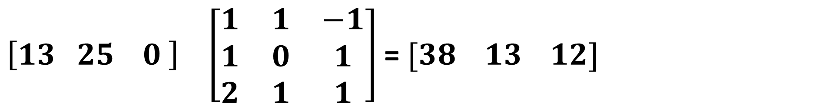
To Encrypt
$\left[13 25 0 \right]$ $\left[\begin{matrix}1 & 1 & −1 \\ 1 & 0 & 1 \\ 2 & 1 & 1\end{matrix}\right]$ = $[38 13 12]$
$\begin{matrix}[6 & 1 & 22] \left[\begin{matrix}1 & 1 & −1 \\ 1 & 0 & 1 \\ 2 & 1 & 1\end{matrix}\right]\end{matrix}$=$\begin{matrix}[51 & 28 & 17]\end{matrix}$
$\begin{matrix}[15 & 21 & 18]\left[\begin{matrix}1 & 1 & −1 \\ 1 & 0 & 1 \\ 2 & 1 & 1\end{matrix}\right]\end{matrix}$=$\begin{matrix}[72 & 33 & 24]\end{matrix}$
$\begin{matrix}[9 & 1 & 20]\left[\begin{matrix}1 & 1 & −1 \\ 1 & 0 & 1 \\ 2 & 1 & 1\end{matrix}\right]\end{matrix}$=$\begin{matrix}[50 & 29 & 12]\end{matrix}$

Slide 11
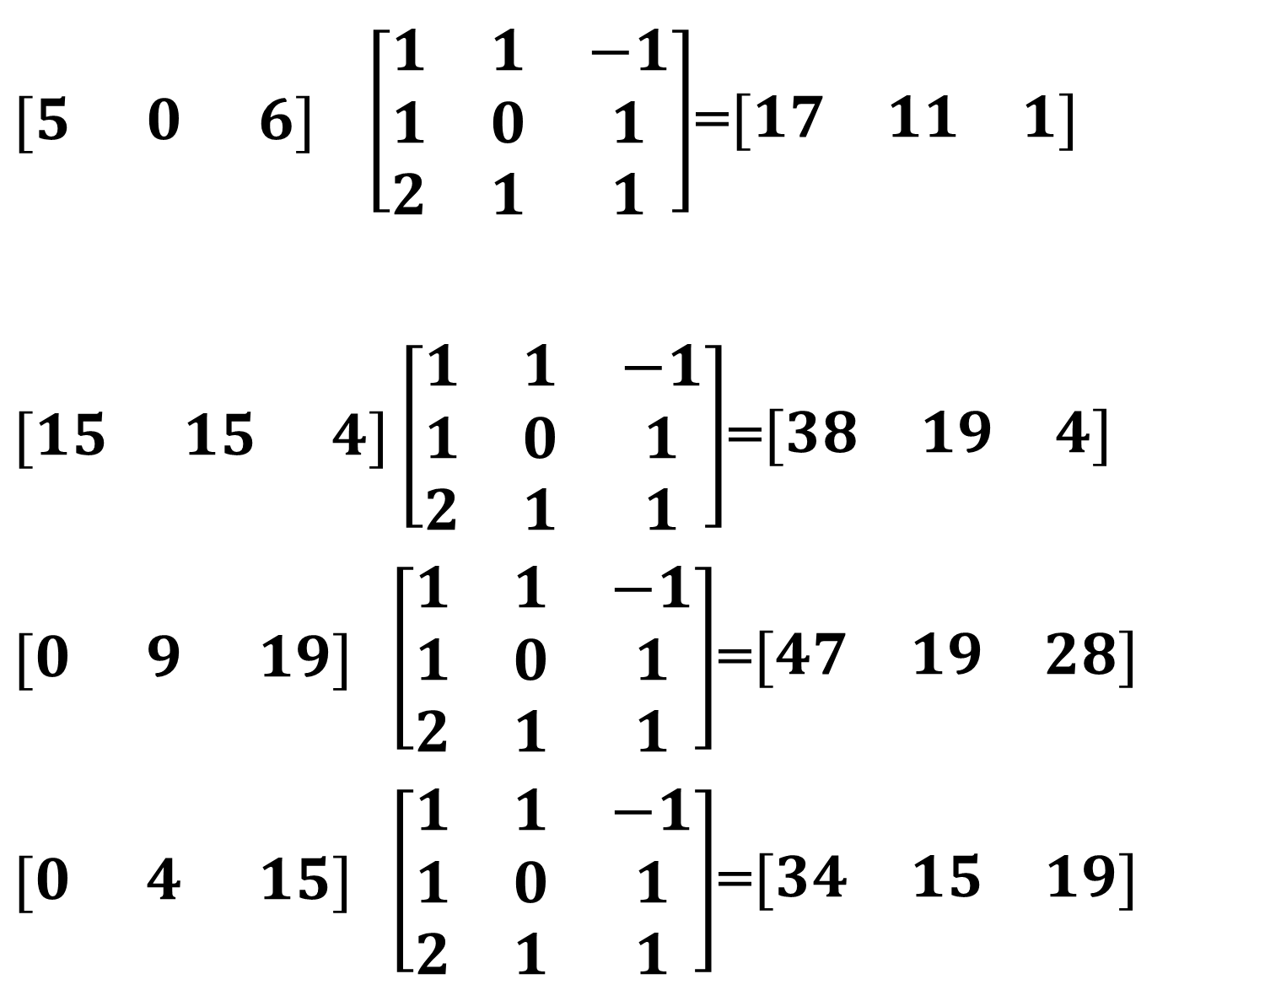
$\begin{matrix}[5 & 0 & 6] \left[\begin{matrix}1 & 1 & −1 \\ 1 & 0 & 1 \\ 2 & 1 & 1\end{matrix}\right]\end{matrix}$=$\begin{matrix}[17 & 11 & 1]\end{matrix}$
$\begin{matrix}[15 & 15 & 4]\left[\begin{matrix}1 & 1 & −1 \\ 1 & 0 & 1 \\ 2 & 1 & 1\end{matrix}\right]\end{matrix}$=$\begin{matrix}[38 & 19 & 4]\end{matrix}$
$\begin{matrix}[0 & 9 & 19] \left[\begin{matrix}1 & 1 & −1 \\ 1 & 0 & 1 \\ 2 & 1 & 1\end{matrix}\right]\end{matrix}$=$\begin{matrix}[47 & 19 & 28]\end{matrix}$
$\begin{matrix}[0 & 4 & 15] \left[\begin{matrix}1 & 1 & −1 \\ 1 & 0 & 1 \\ 2 & 1 & 1\end{matrix}\right]\end{matrix}$=$\begin{matrix}[34 & 15 & 19]\end{matrix}$

Slide 12
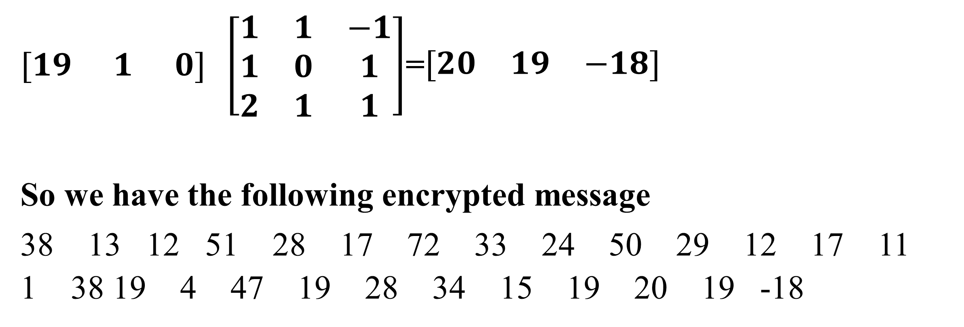
$\begin{matrix}[19 & 1 & 0] \left[\begin{matrix}1 & 1 & −1 \\ 1 & 0 & 1 \\ 2 & 1 & 1\end{matrix}\right]\end{matrix}$=$\begin{matrix}[20 & 19 & −18]\end{matrix}$
So we have the following encrypted message
38 13 12 51 28 17 72 33 24 50 29 12 17 11 1 38 19 4 47 19 28 34 15 19 20 19 -18

Slide 13
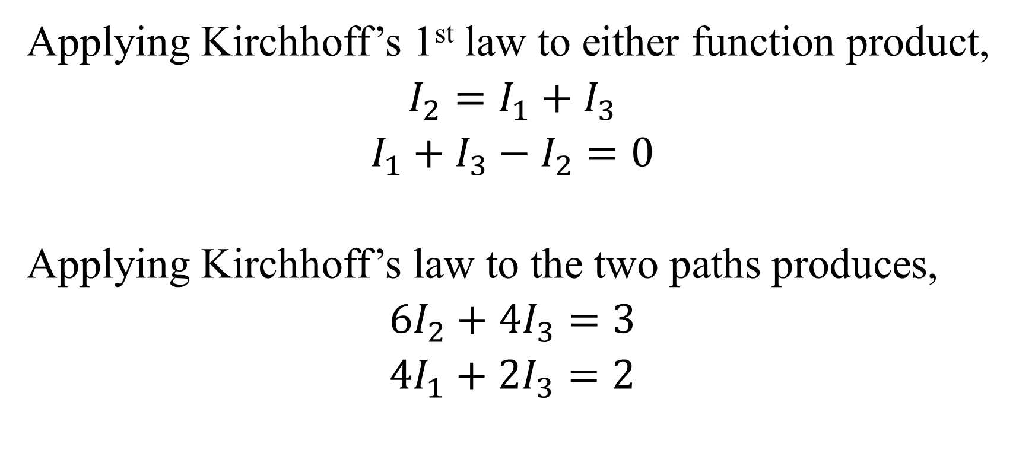
3. Determine the currents for the electrical network shown in the following figure:
Salutation:
Applying Kirchhoff’s 1st law to either function product,
$$I_{2}=I_{1}+I_{3}$$
$$I_{1}+I_{3}−I_{2}=0$$
Applying Kirchhoff’s law to the two paths produces,
$${6I}_{2}+{4I}_{3}=3$$
$${4I}_{1}+{2I}_{3}=2$$

Slide 14


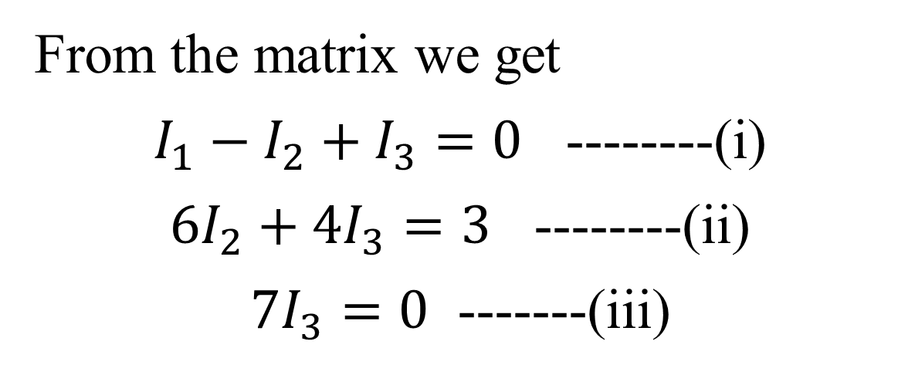
From the matrix we get
$I_{1}−I_{2}+I_{3}=0$ --------(i)
${6I}_{2}+{4I}_{3}=3$ --------(ii)
${7I}_{3}=0$ -------(iii)
The Augmented Matrix is,
$$\left[\begin{matrix}1 & −1 & 1 & 0 \\ 0 & 6 & 4 & 3 \\ 4 & 0 & 2 & 2\end{matrix}\right]$$
= $\left[\begin{matrix}1 & −1 & 1 & 0 \\ 0 & 6 & 4 & 3 \\ 0 & 4 & −2 & 2\end{matrix}\right]$
$$=\left[\begin{matrix}1 & −1 & 1 & 0 \\ 0 & 6 & 4 & 3 \\ 0 & 0 & 7 & 0\end{matrix}\right]$$
So, 7$I_{3}=0$
$$I_{3}=0$$
And, ${6I}_{2}+{4I}_{3}=3$
$${6I}_{2}+0=3$$
$$I_{2}=\frac{1}{2}$$
$I_{1}$= $I_{2}$

Slide 15
Real Life Example of Matrix
Encryption
Games especially 3D
Economics and Business
Construction
Animation
Physics

Slide 16
Any
Question?

Slide 17

Thank You

